Slide 1
Monthly trends on smoking in Scotland from the Smoking Toolkit Study
Vera Buss, Robert West, Loren Kock, Dimitra Kale, Jamie Brown

Slide 2
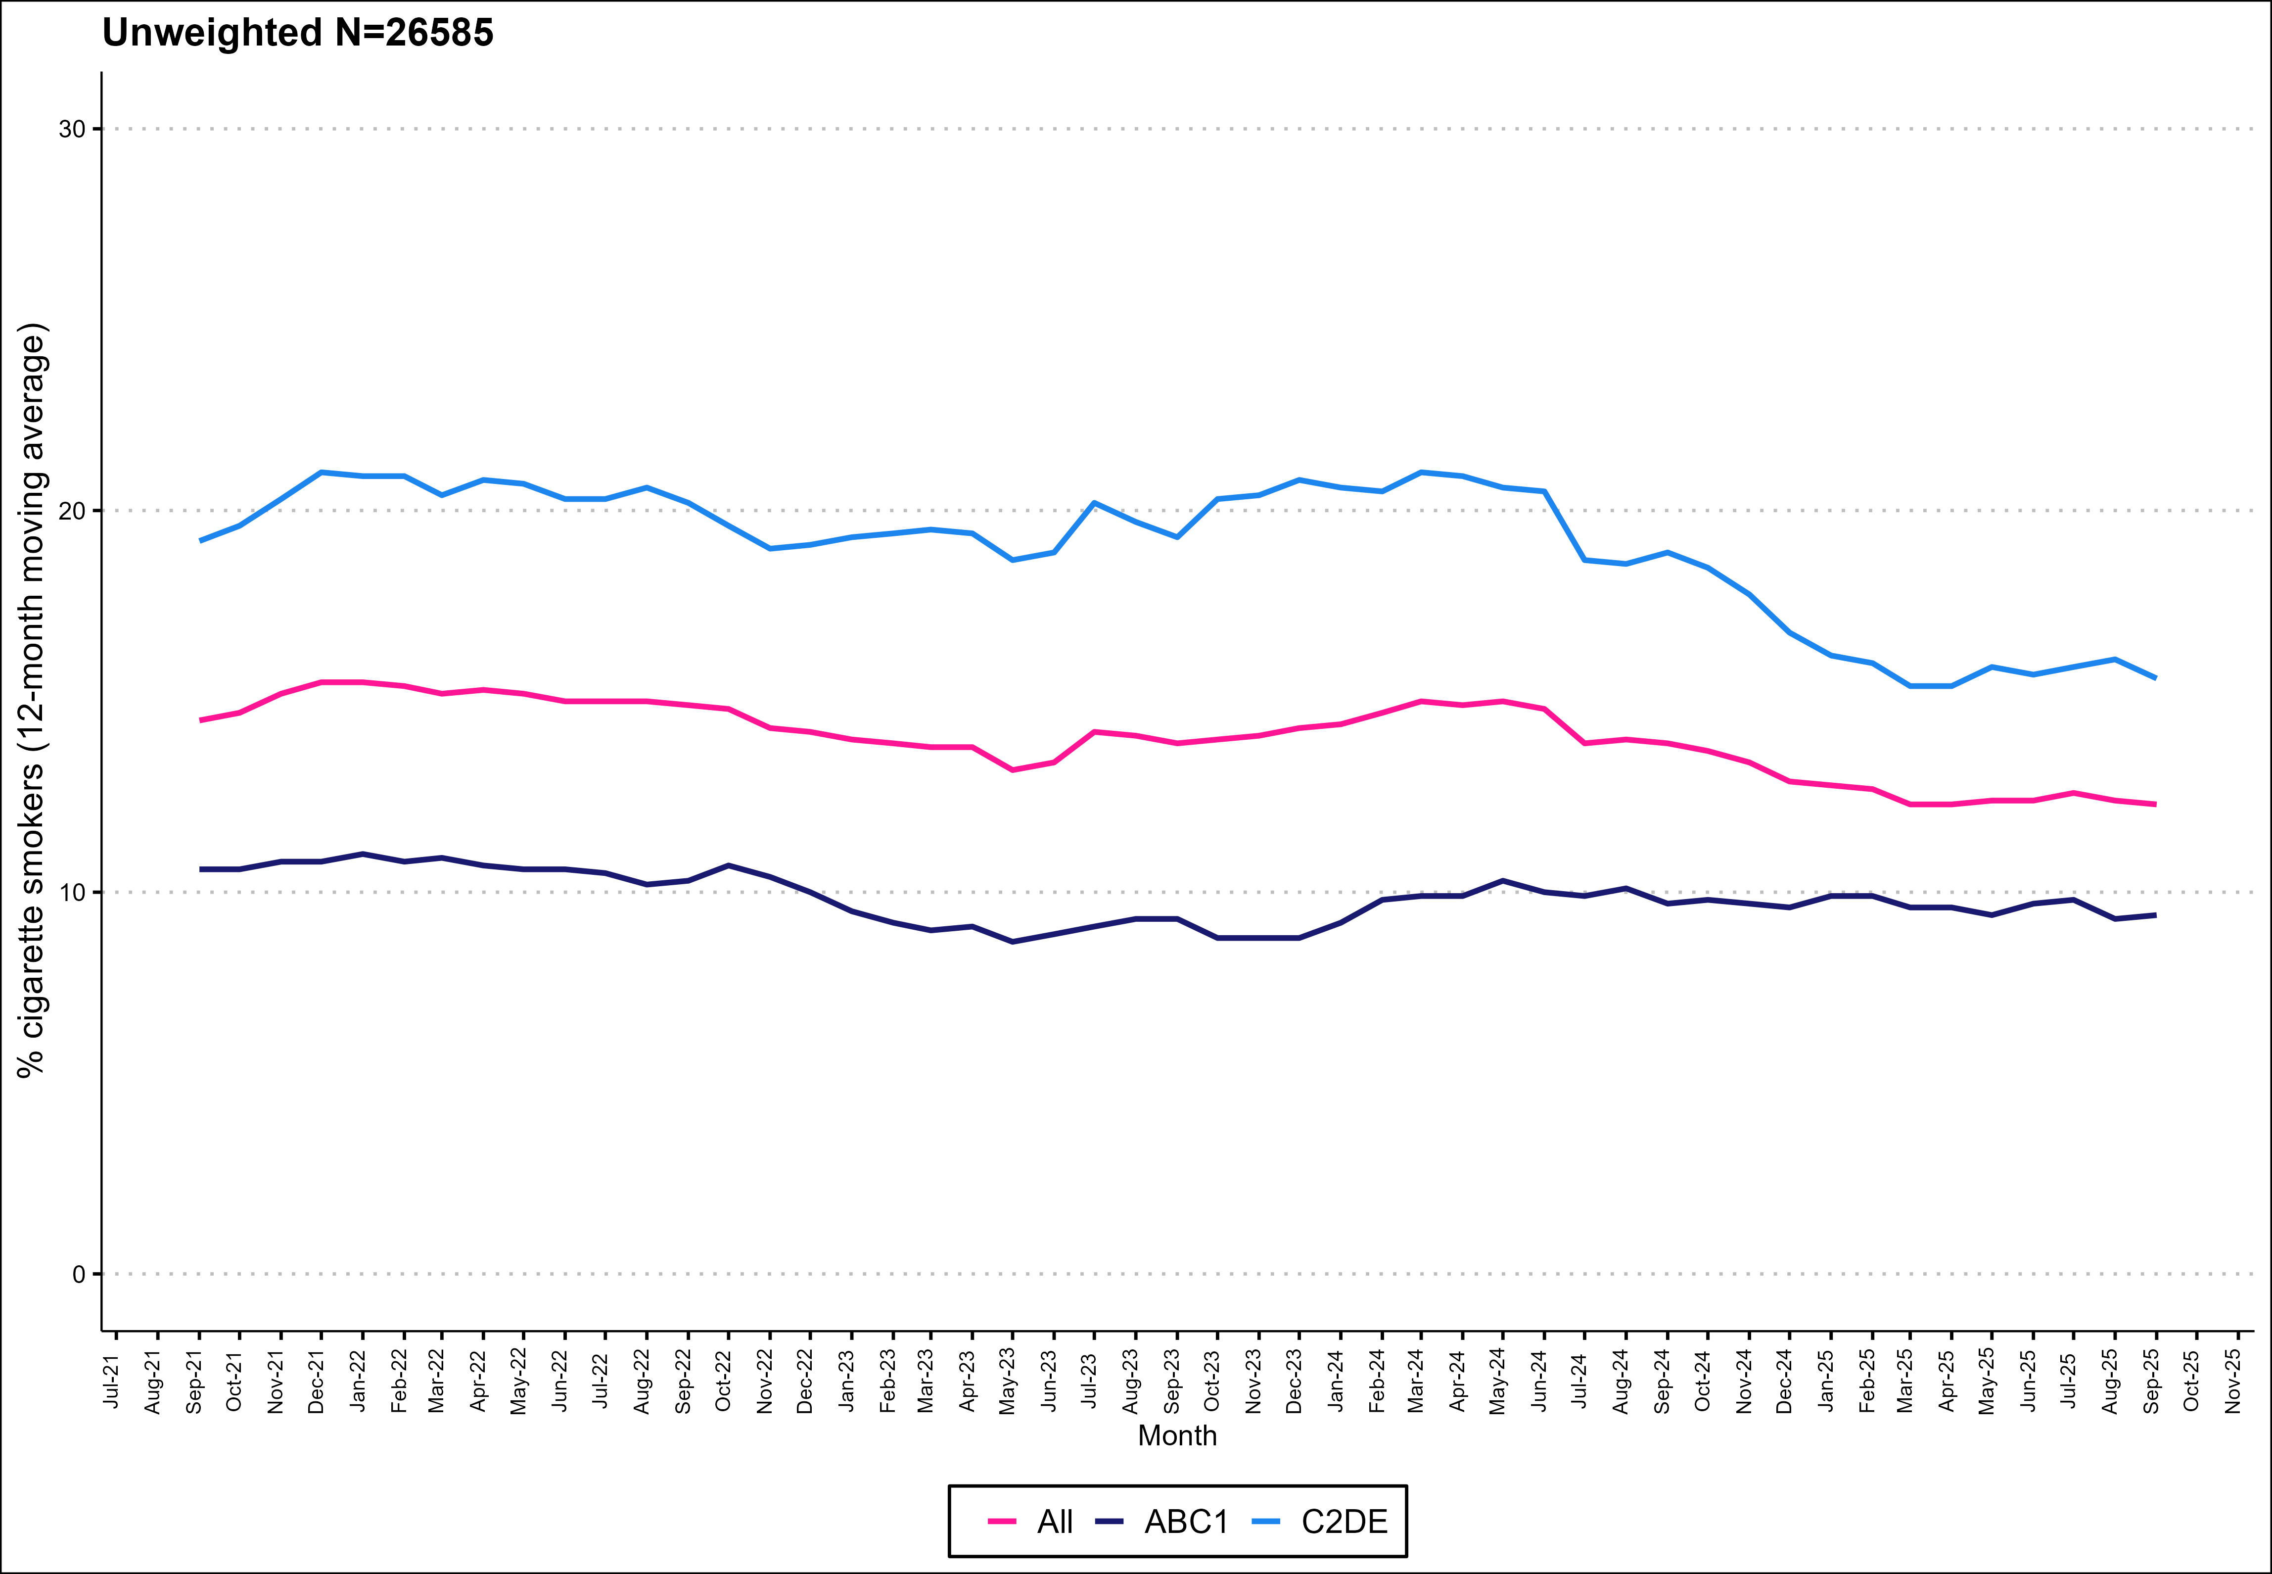
Prevalence of cigarette smoking by social grade

Slide 3
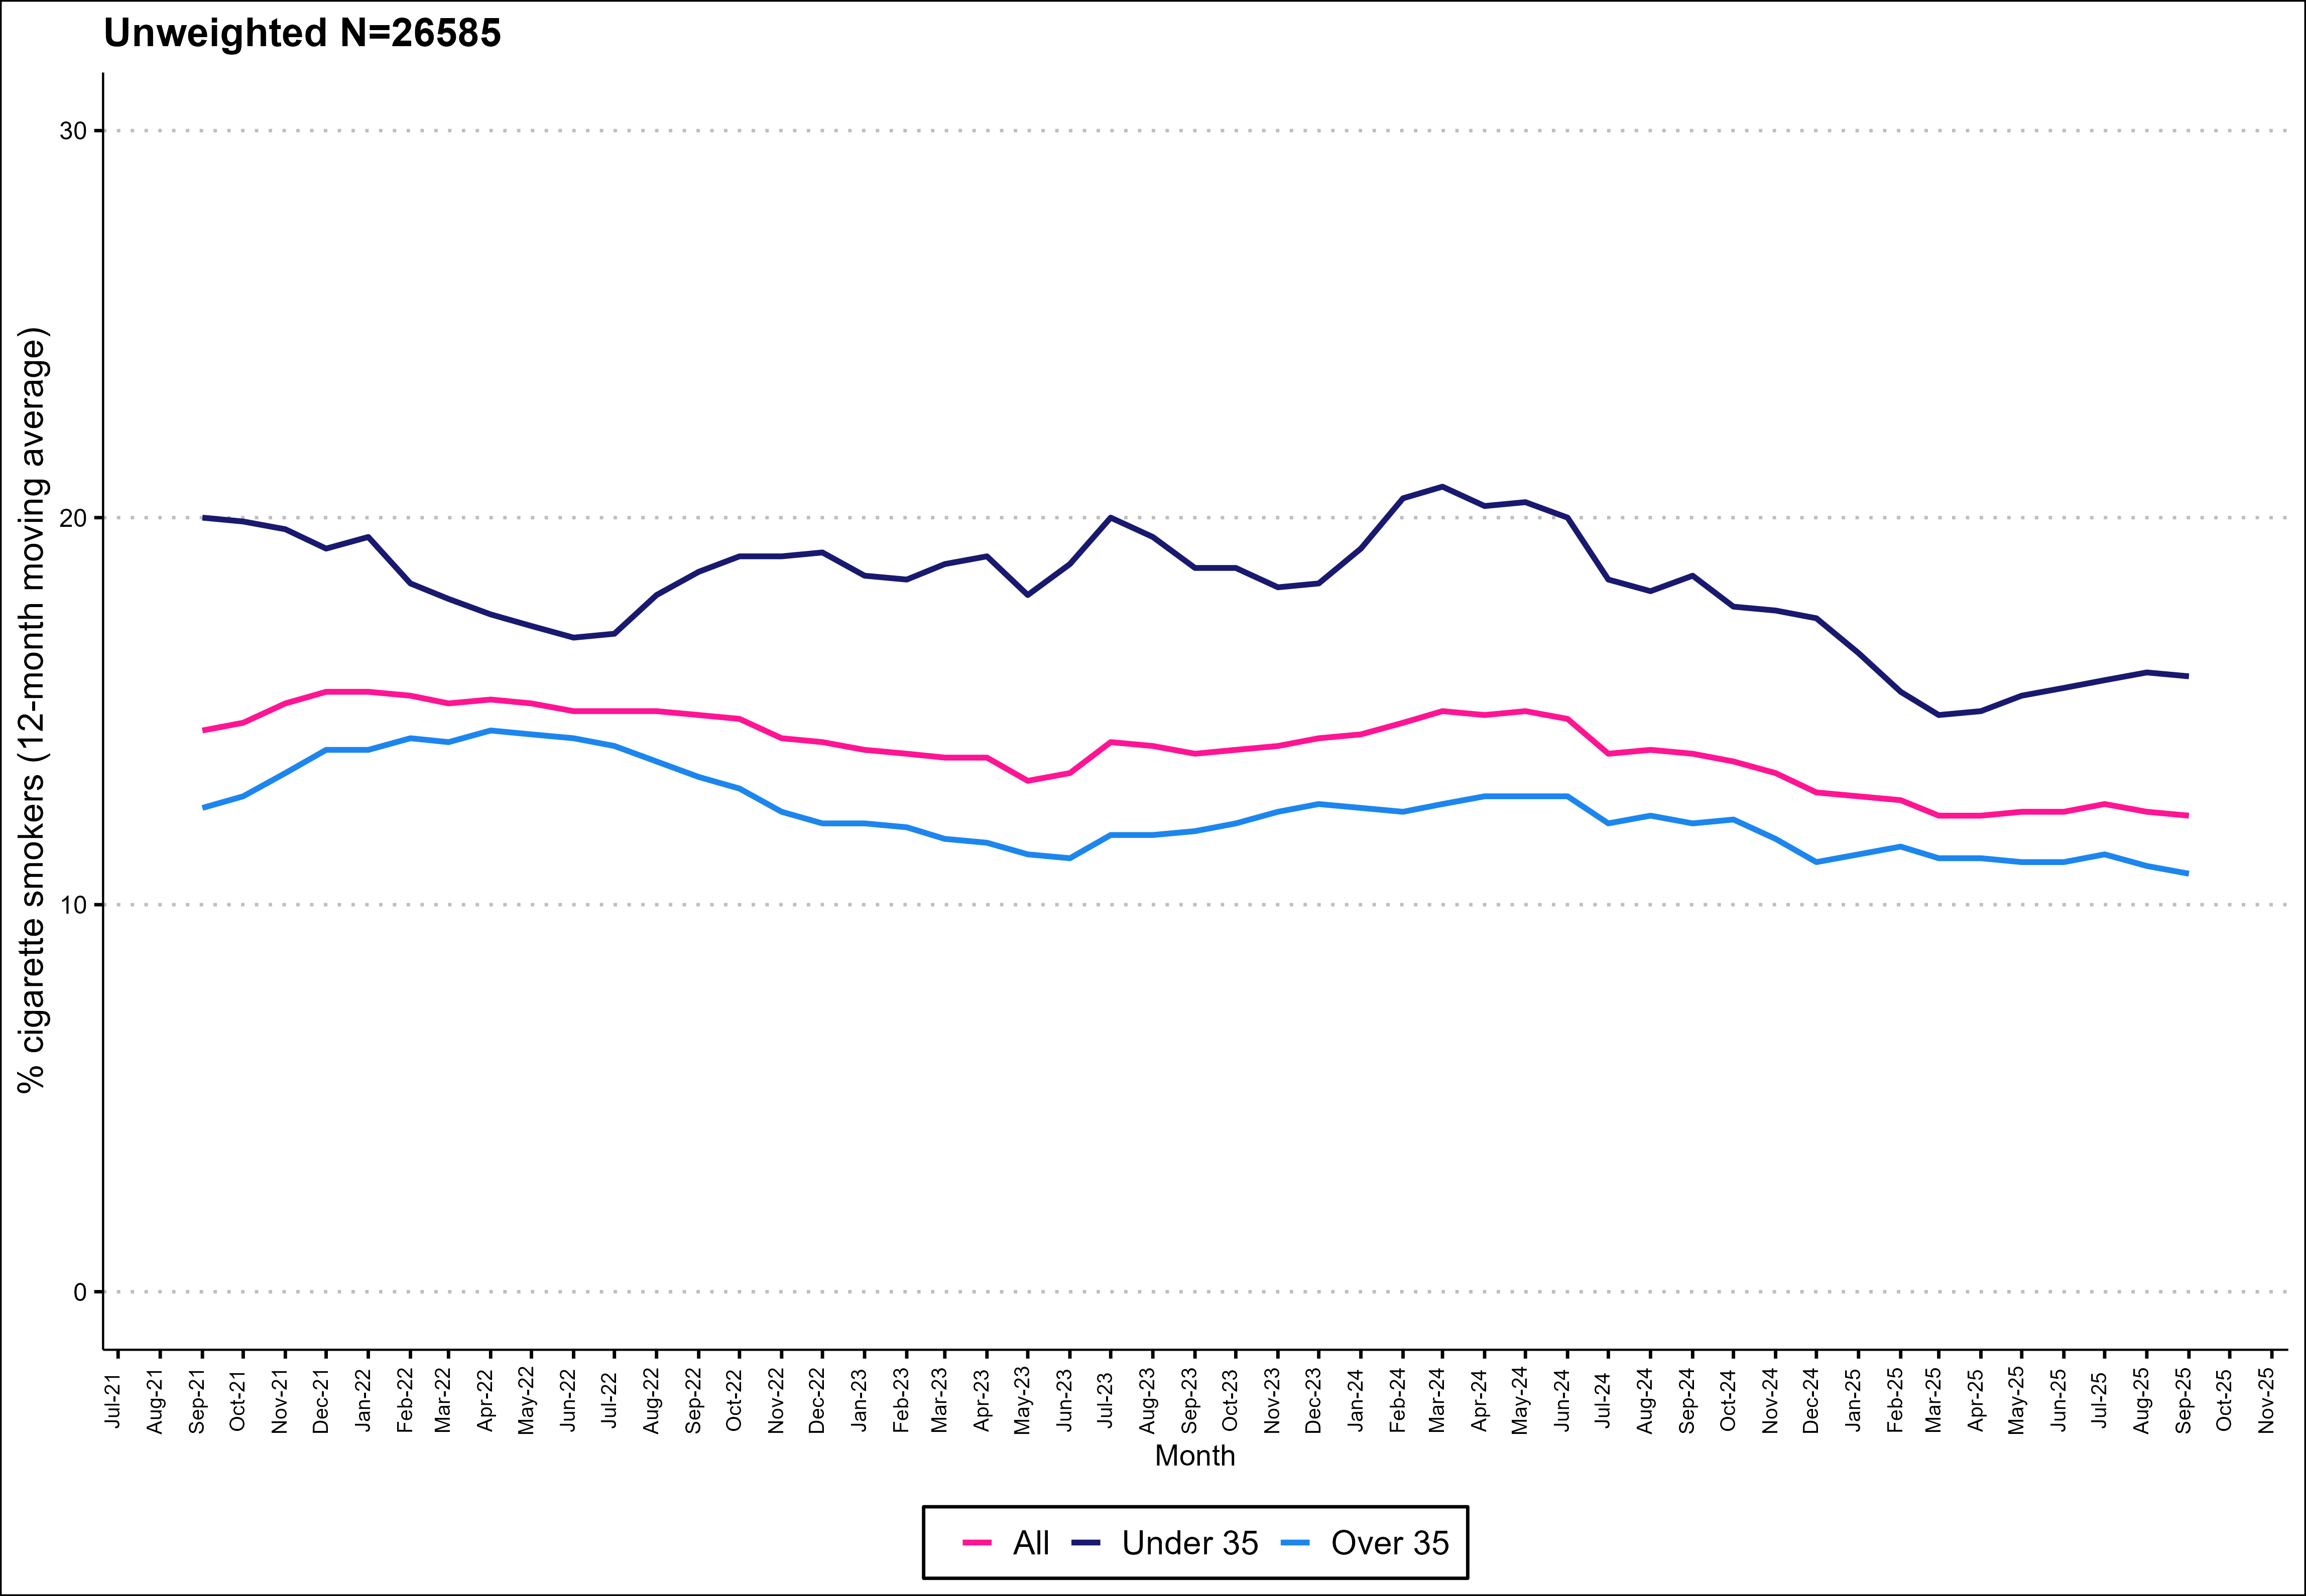
Prevalence of cigarette smoking by age

Slide 4
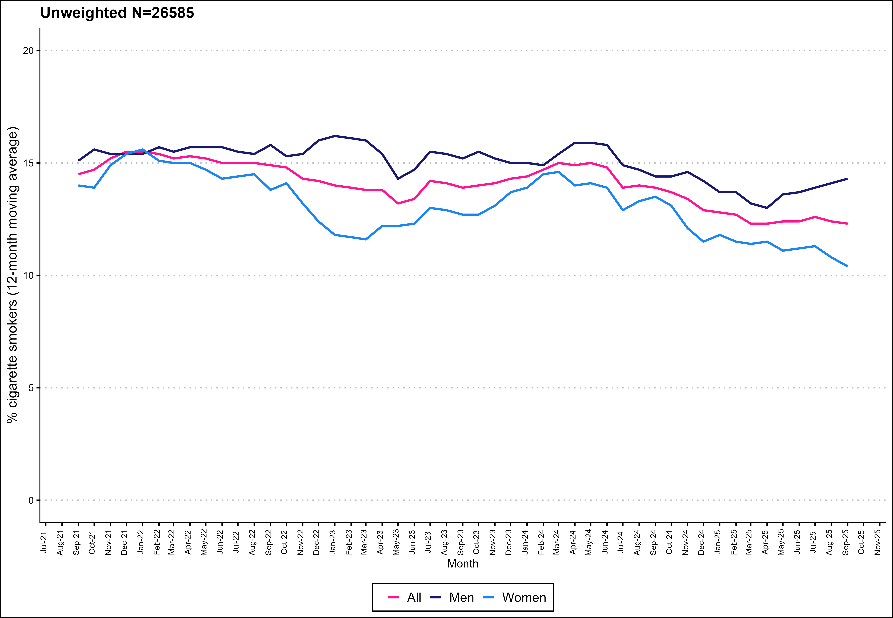
Prevalence of cigarette smoking by gender

Slide 5
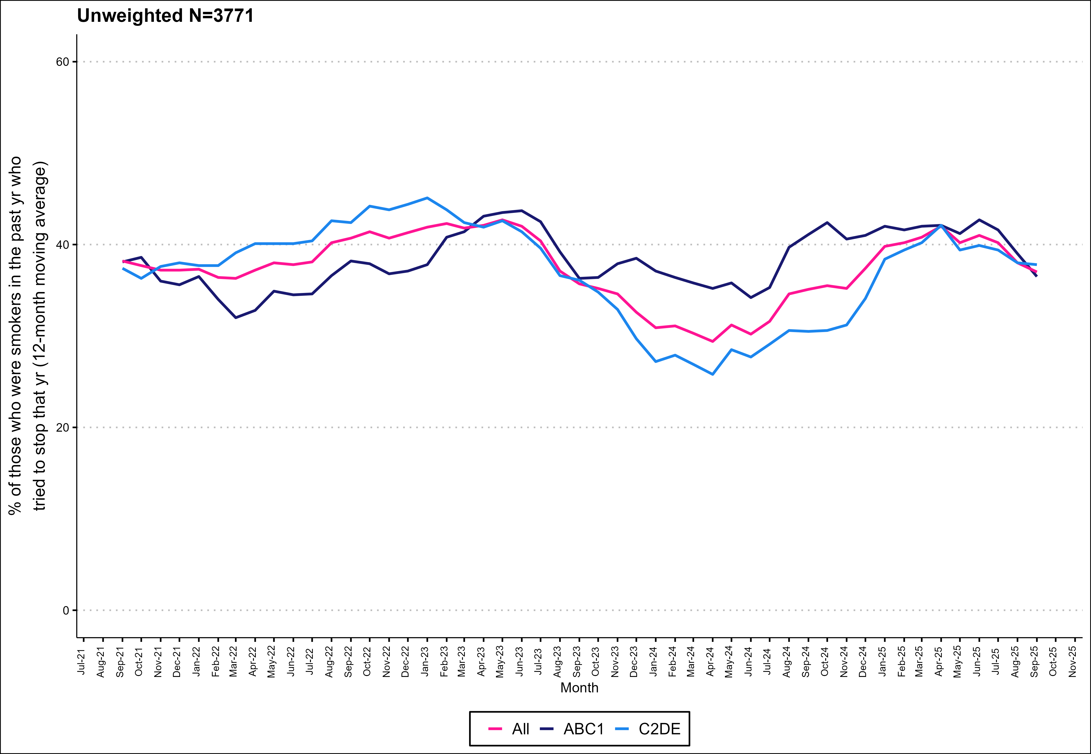
Attempts to stop by social grade

Slide 6
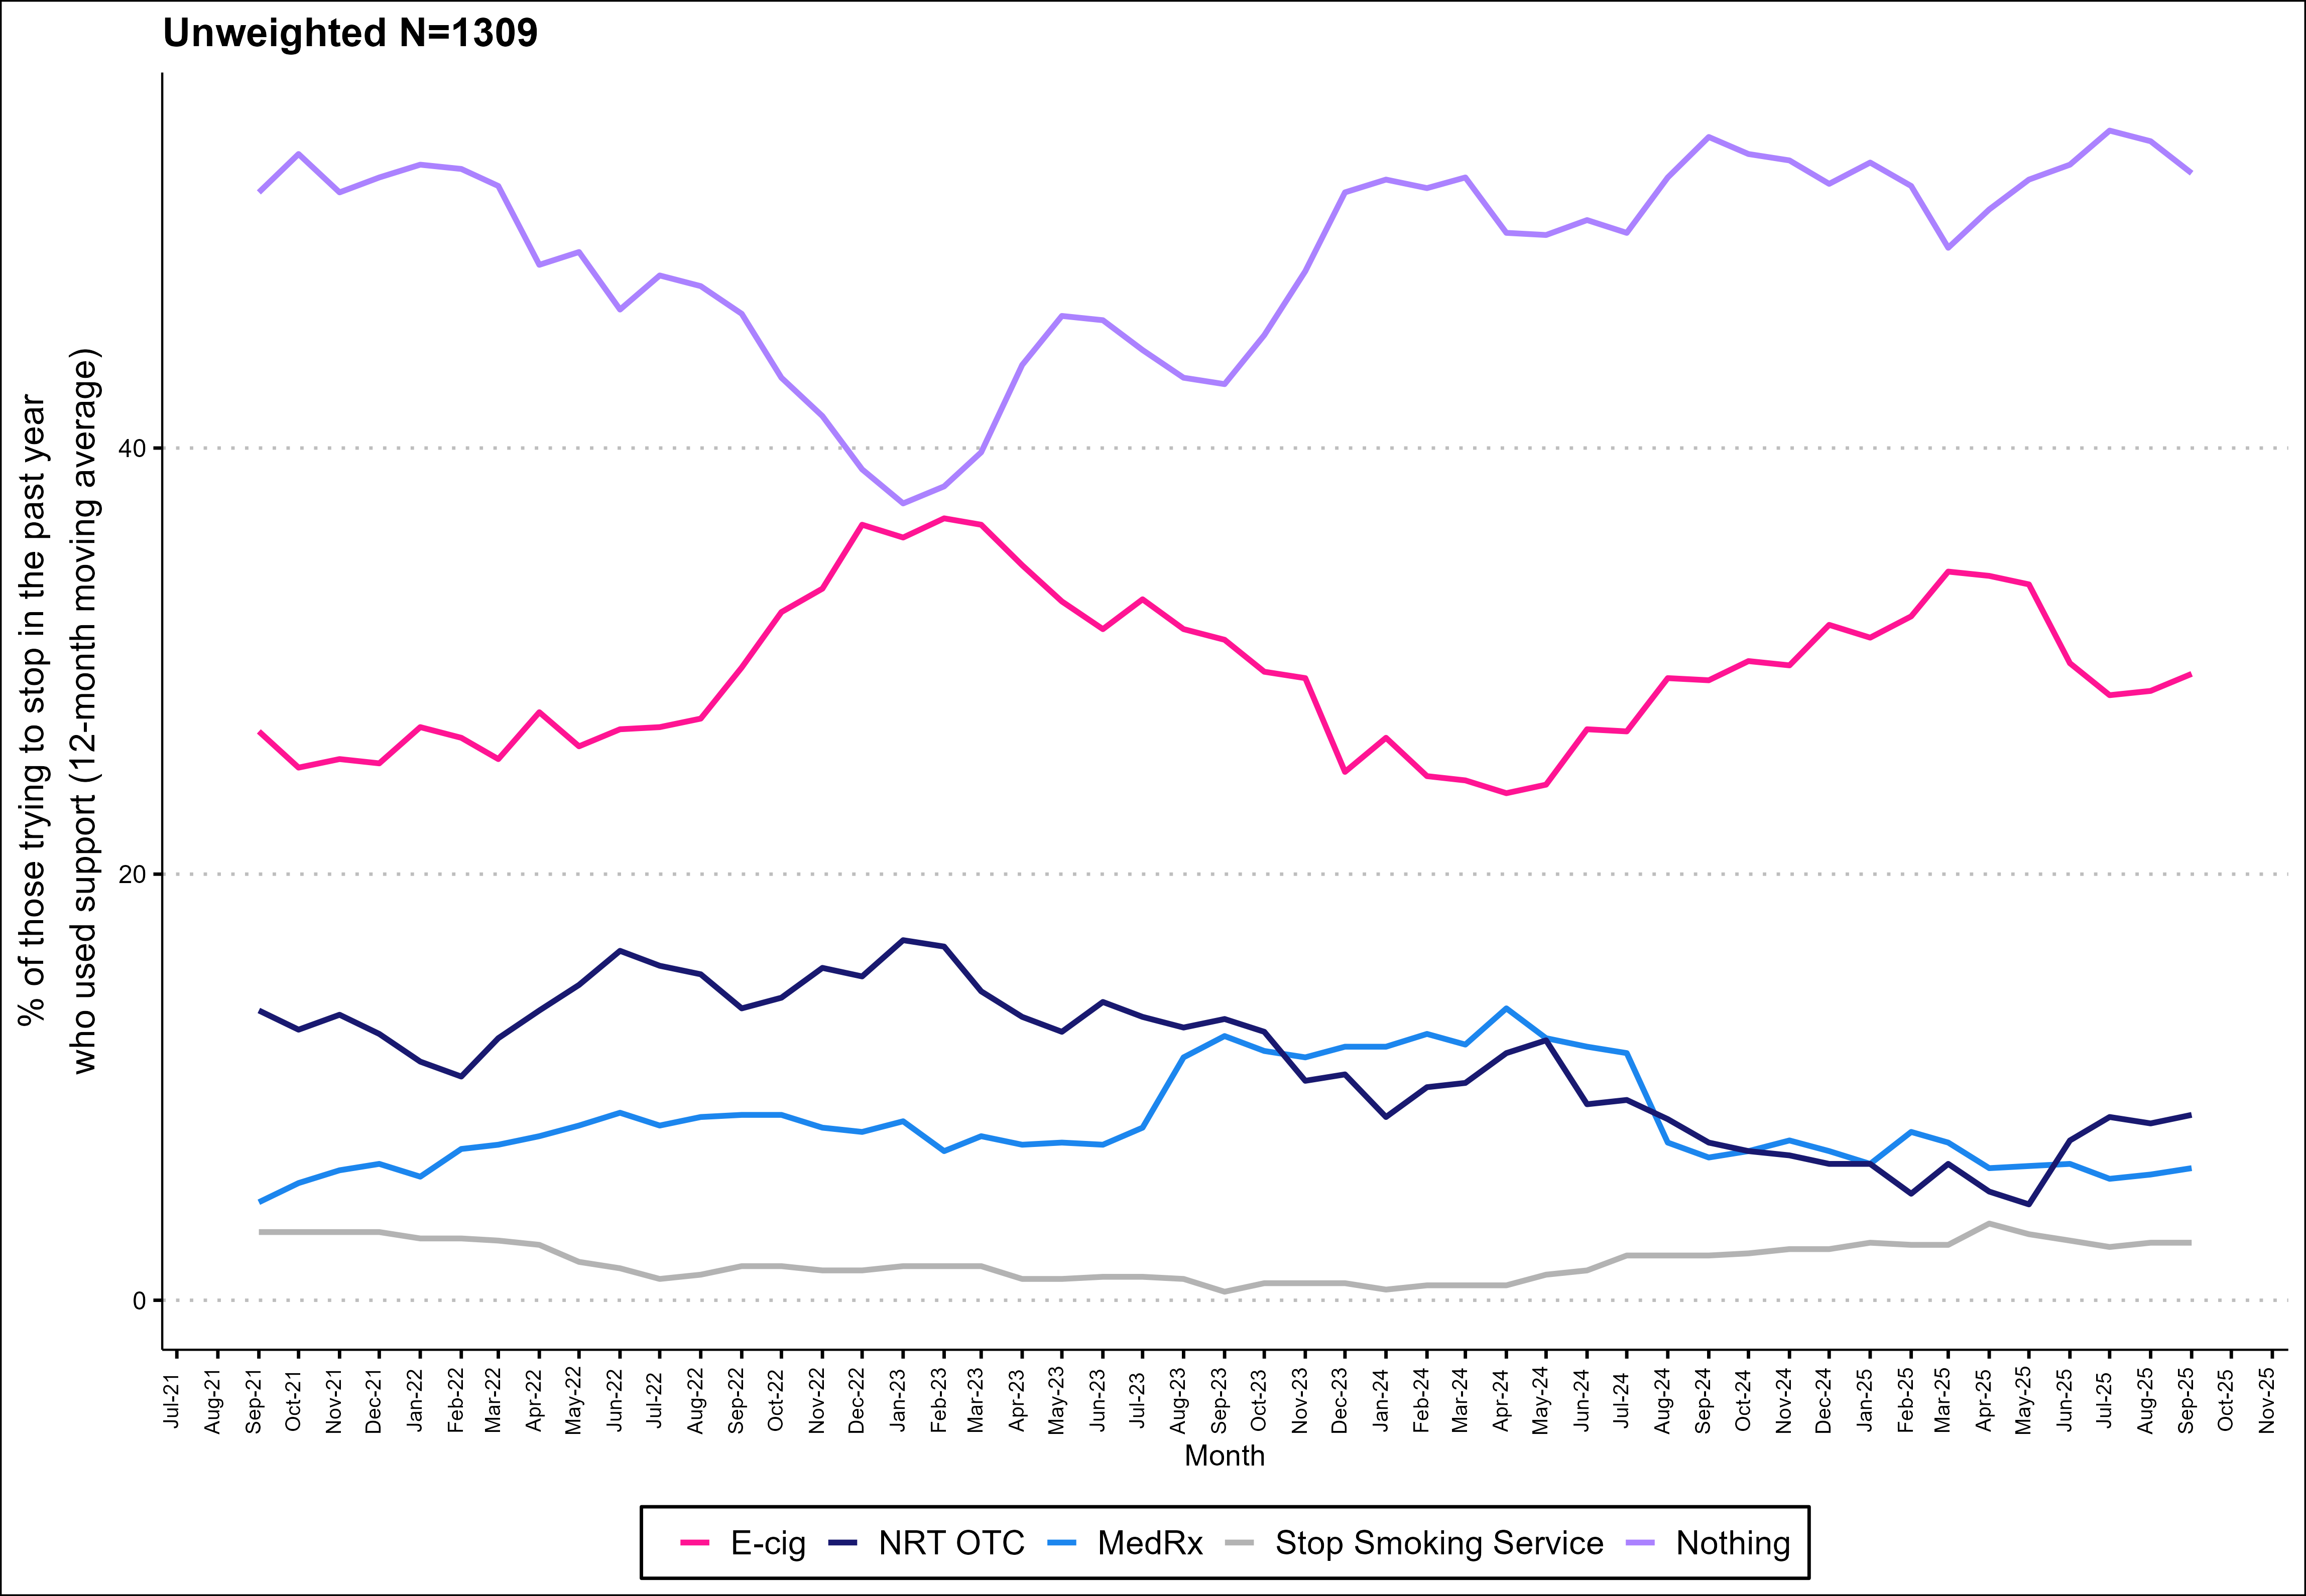
Support used in quit attempts

Slide 7
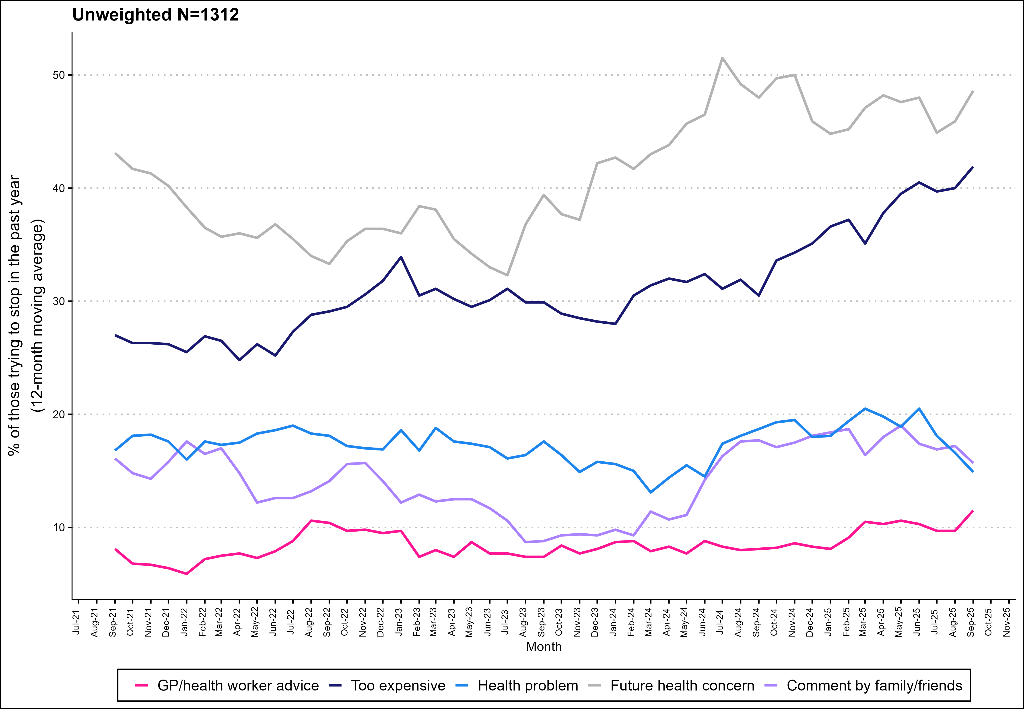
Common triggers for quit attempts

Slide 8
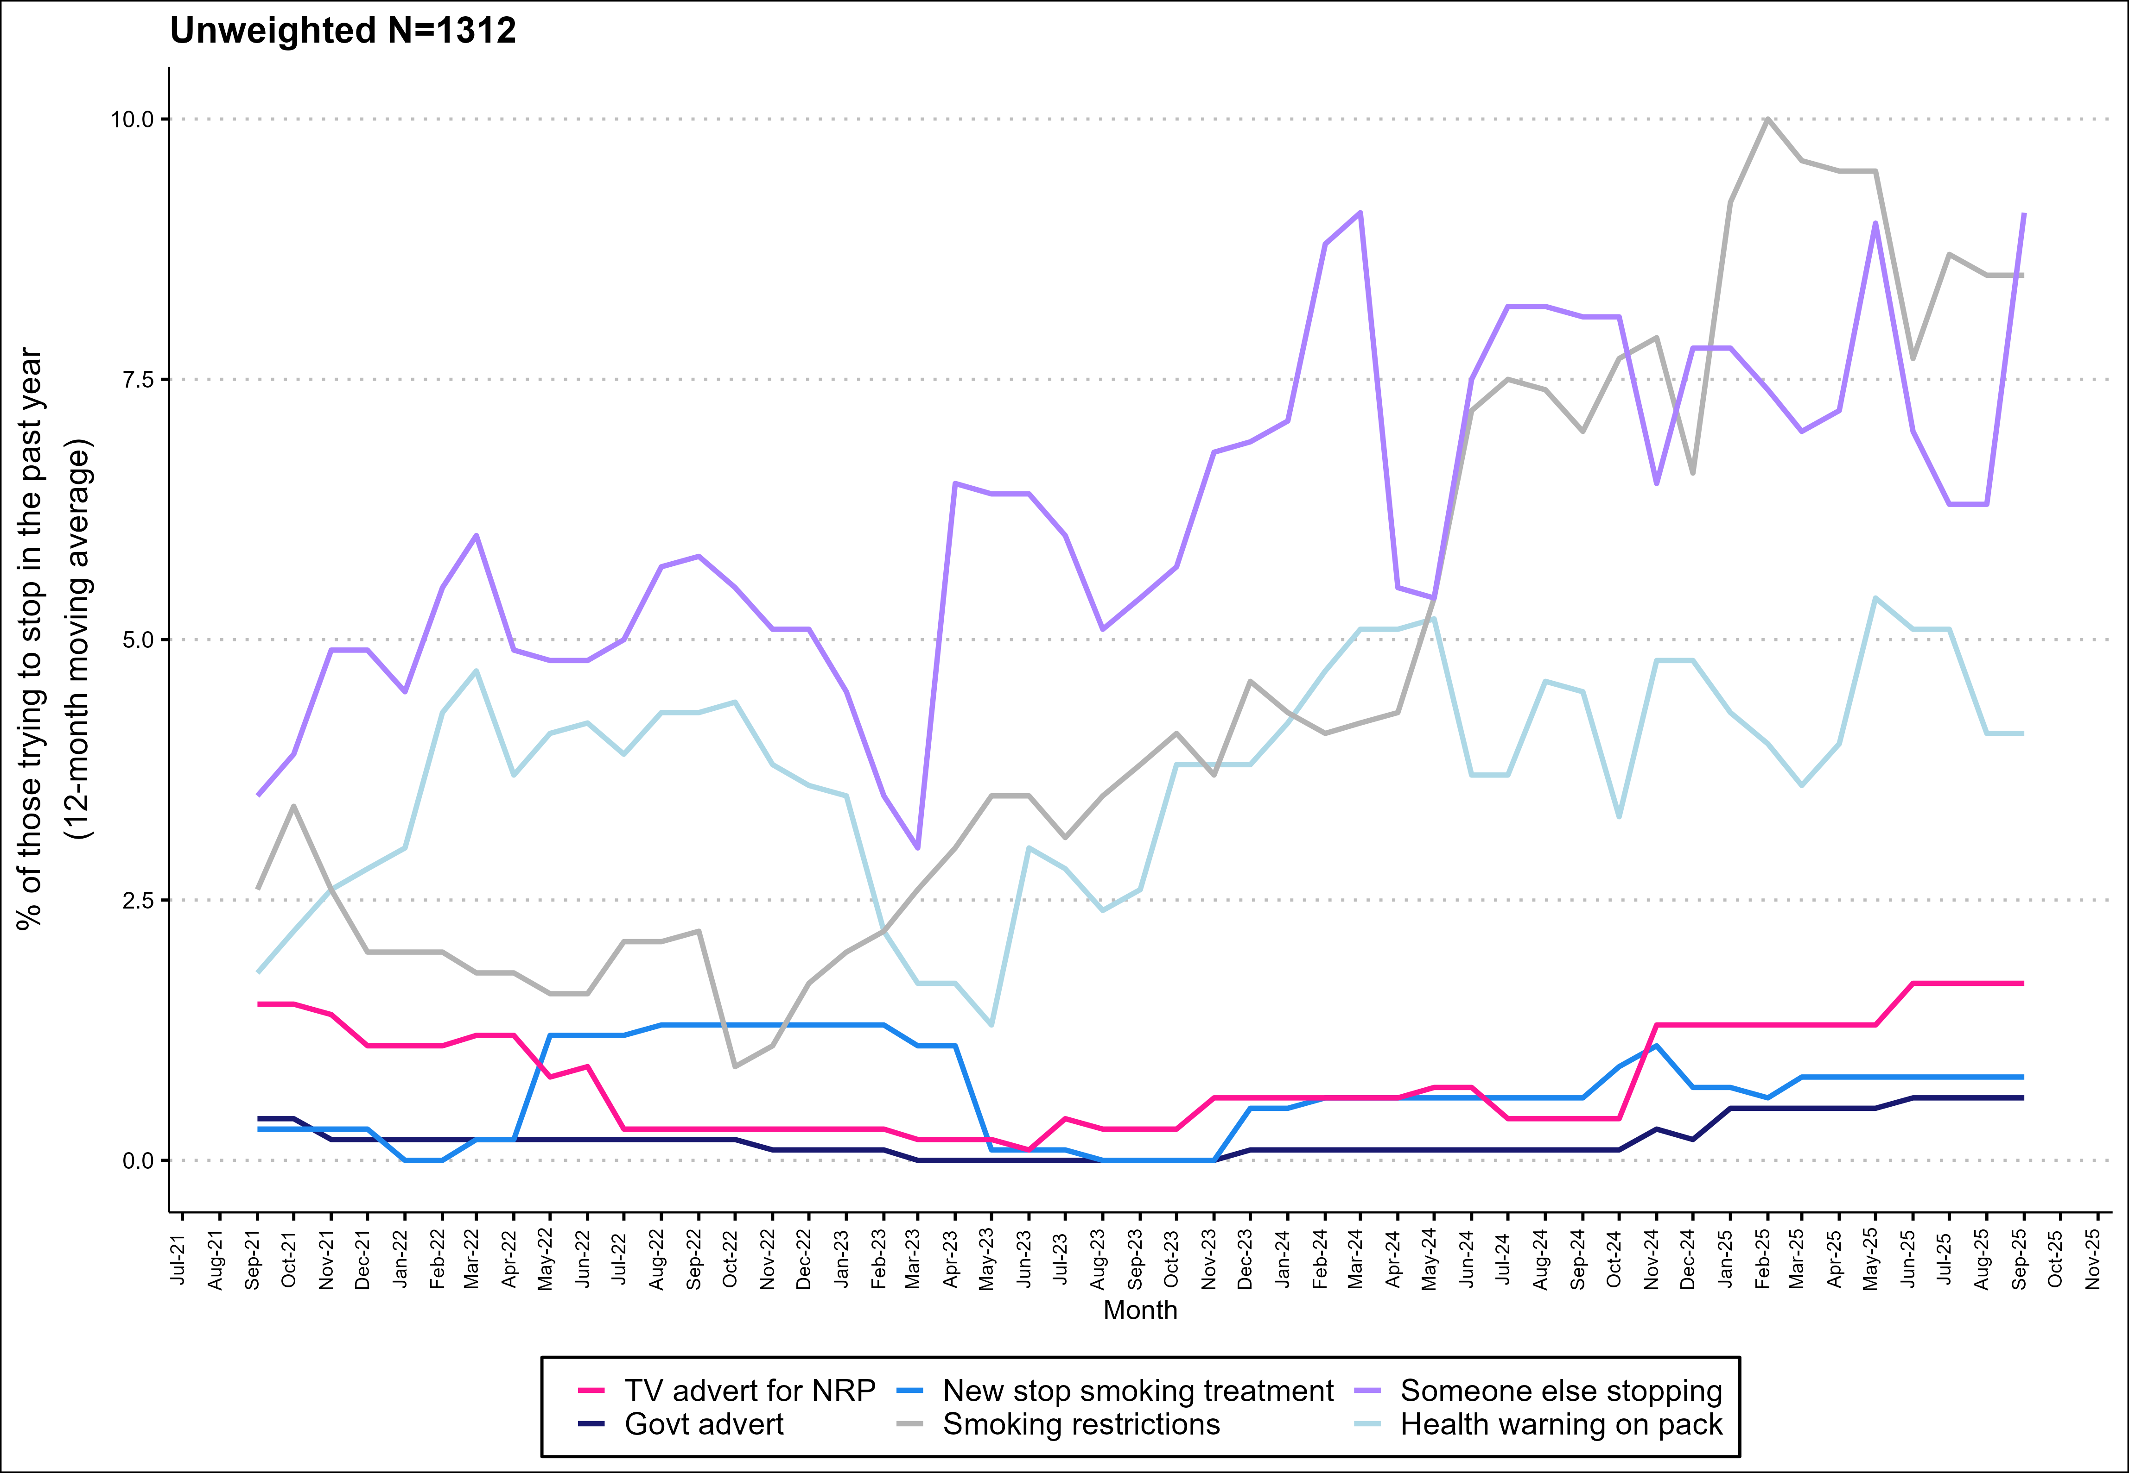
Less common triggers for quit attempts

Slide 9
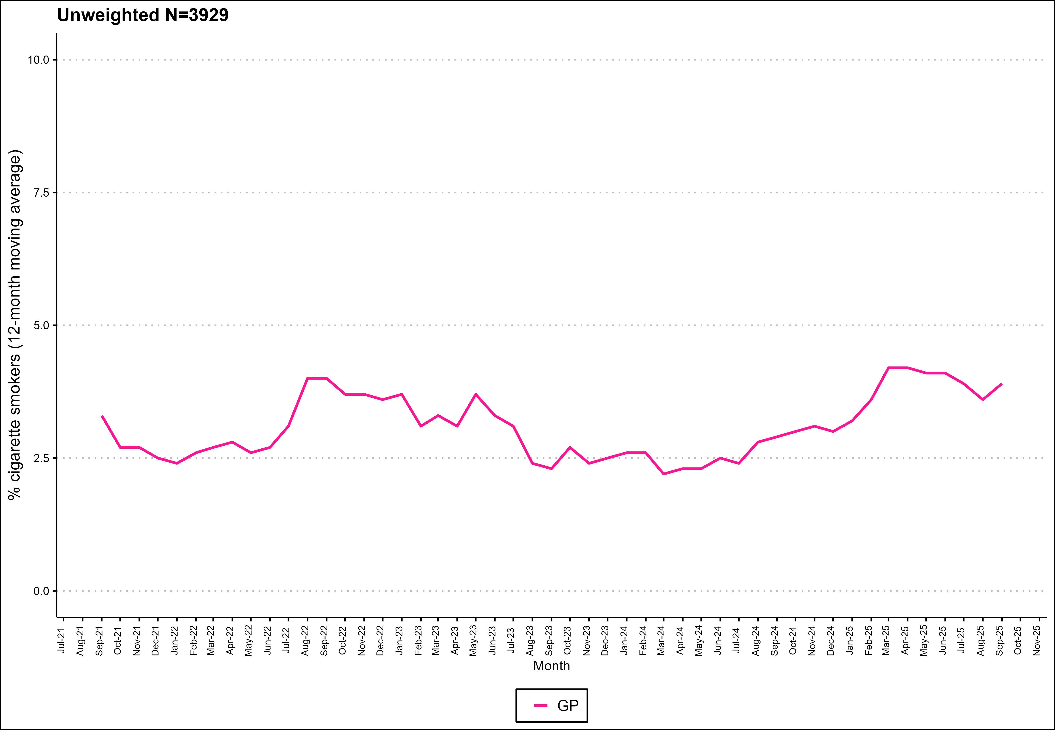
GP-triggered quit attempts

Slide 10
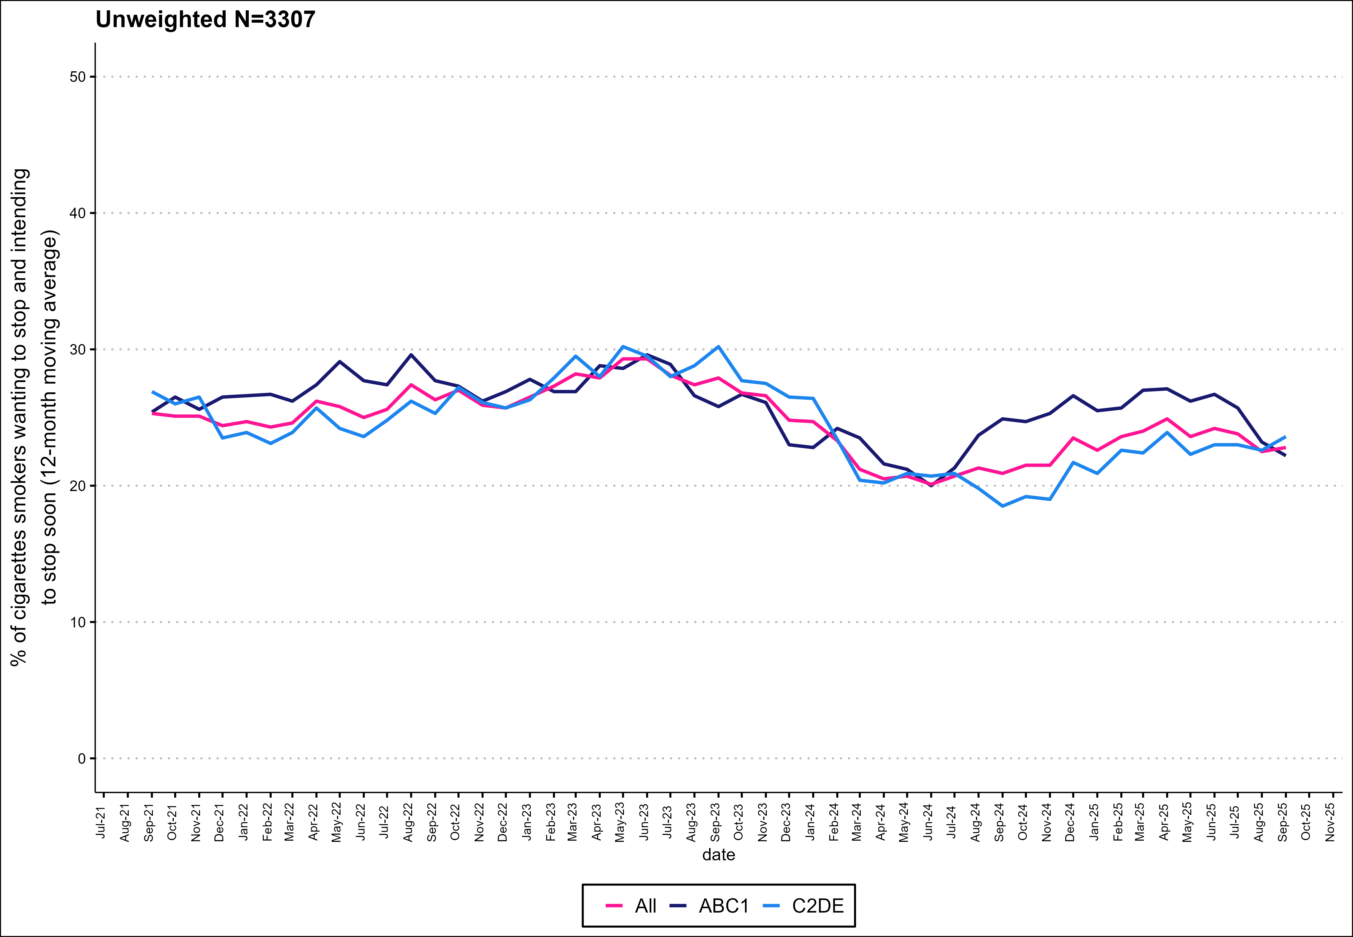
Motivation to quit

Slide 11
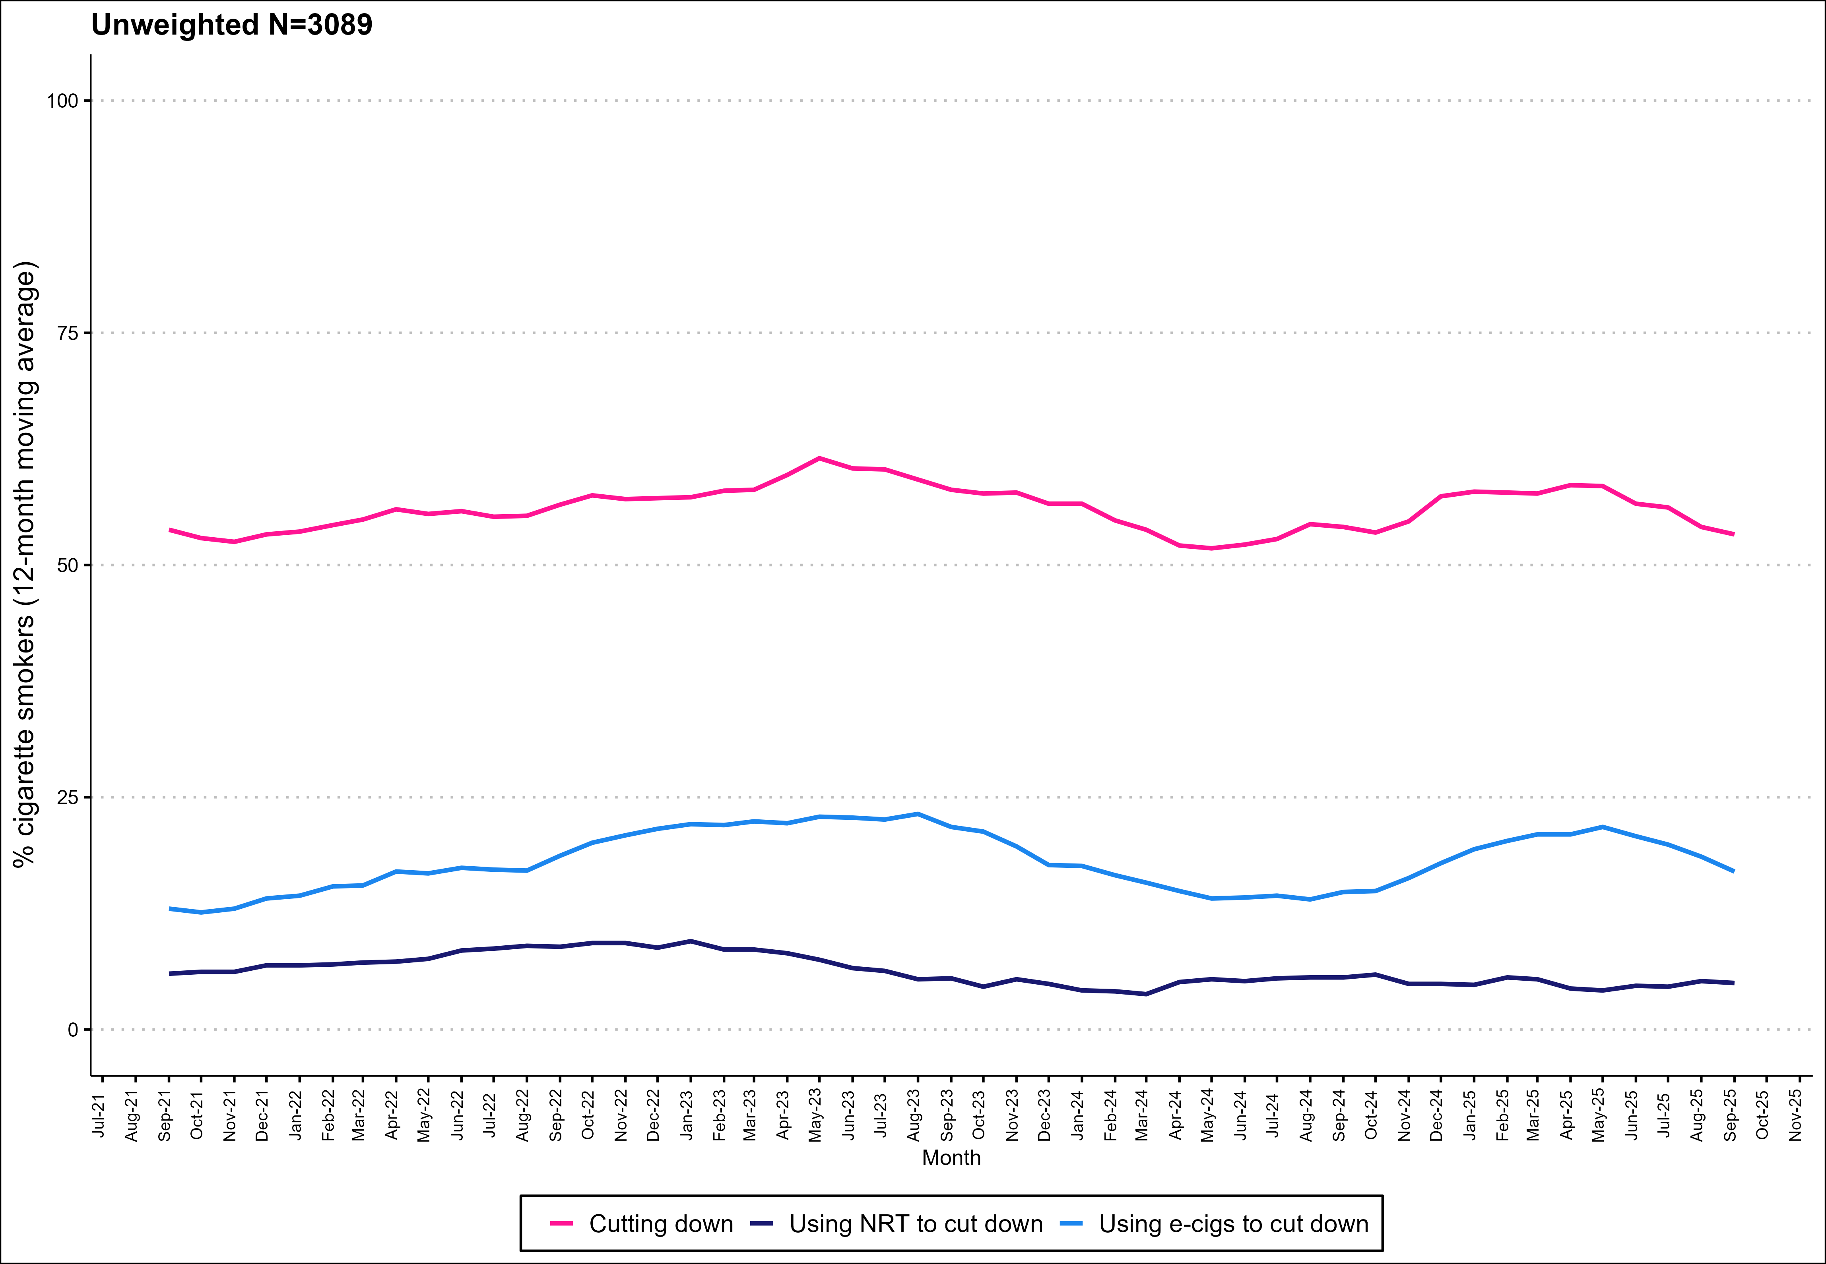
Harm reduction

Slide 12
Methods
Data collected during monthly household survey
Each month involves a new representative sample of 400-450 adults (18 and over)
  From April 2020-December 2021, surveys were conducted by telephone and among adults aged 18. From January 2022 surveys included adults aged 16+.
Kock, et al., 2021. Protocol for expansion of an existing national monthly survey of smoking behaviour and alcohol use in England to Scotland and Wales: The Smoking and Alcohol Toolkit Study. Wellcome Open Research. 6:67
For more information (including the data underlying each graph) visit www.smokinginscotland.info

